Slide 1

Predicting Housing Market Trends: A Data-Driven Approach to Price Forecasting
Course :- DSCI 8950 Presented To:- Lochana Palayangoda
Presented By:- Amarnath Kommineni Kavya Gurram Sandeep Borwal Vikas Kumar Reddy Buchammagari

Slide 2
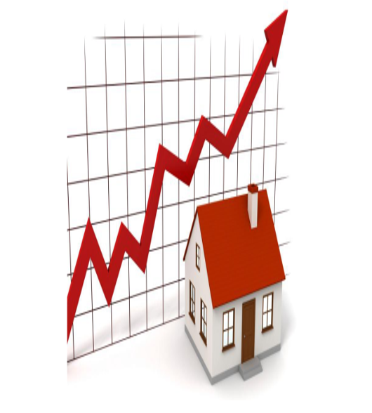
Problem Statement
How accurately can we predict housing prices using machine learning models based on property features and market conditions.
Identify most important features affecting price?
Notes:
Introduction
The real estate market significantly impacts the global economy.
Housing prices depend on multiple factors like location, size, and market trends.
Traditional pricing methods are subjective, time-consuming, and prone to errors.
Problem Statement
Estimating property values accurately remains a challenge.
Current appraisal methods lack efficiency and objectivity.
Solution: Machine Learning Model
Leverages historical data to identify patterns and correlations.
Improves accuracy by reducing human bias in price estimation.
Provides quick, data-driven predictions based on market conditions.
Project Goal
Develop a machine learning model to predict housing prices.
Use key property attributes and economic indicators for training.
Enhance reliability and efficiency in real estate pricing.

Slide 3
Objective of the Study
Leverages historical data to identify patterns and correlations.
Improves accuracy by reducing human bias in price estimation.
Provides quick, data-driven predictions based on market conditions.
Develop a machine learning model to predict housing prices.

Slide 4
📊 Data Overview
📈 Supplementary Economic Indicators:
Personal Income
Population Growth
Per Capita Income
Economic data has been merged with Zillow records for enhanced analysis.
📊 Data Overview
🏠 Property Types Analyzed (Zillow Dataset):
Single Family Homes – 10.5K records
Two Bedroom Homes – 10.5K records
Three Bedroom Homes – 10.5K records
All Homes (General) – 10.5K records
Condos – 10.5K records
Each property type dataset contains approximately 10,500 records.
🌎 Granularity:
County-Level Analysis
🗓️ Time Frame:
2020 to 2024
📚 Data Sources:
Zillow Real Estate Dataset
U.S. Bureau of Economic Analysis

Slide 5
Data Cleaning & Preprocessing
Zillow Dataset - multiple files with real estate and per capita income data.
Files Included:
Counties-level per capita income and housing values
Zillow Home Value Index
Population, Income data
Merging files
Rename columns to make meaningful names
Adding longitude,latitude,FIPS
Format data types & Removed missing values
Notes:
Zillow Dataset contains multiple files with real estate and per capita income data.
Files Included:
Counties-level per capita income and housing values
Zillow Home Value Index (ZHVI) for 2-bedroom and 3-bedroom homes
Income data at the county and zip code levels
Merging the files to make a common file
Rename columns to make menaingfull names
Adding longitude,latitude,FIPS to show for maps
Added data for Per_Capita_Income_Growth, Population_Growth, Personal_Income_Growth
Removed missing values

Slide 6
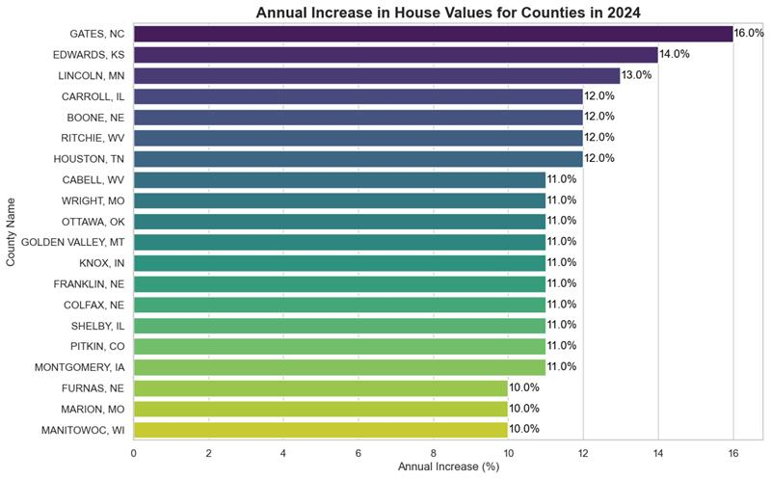
Annual Increase in House Values
Top Performers:
GATES, NC: Leading with a 15.0% increase.
EDWARDS, KS: Close behind with a 14.0% increase.
LINCOLN, MO and CARROLL, NE: Both showing a 12.0% increase.
Notes:
The bar chart titled "Annual Increase in House Values for Counties in 2024" illustrates the percentage increase in house values across various counties. Here are the key points:
Top Performers:
GATES, NC: Leading with a 15.0% increase.
EDWARDS, KS: Close behind with a 14.0% increase.
LINCOLN, MO and CARROLL, NE: Both showing a 12.0% increase.
Moderate Increases:
BOONE, NC: 11.0%
HARLAN, WI: 10.0%
WORTH, IA and CAMBEL, WV: Both at 9.5%
WIRT, OH: 9.2%
Lower Increases:
ORANGEVILLE, NY: 8.7%
GOLDEN VALLEY, MT: 8.5%
KNOX, IN: 8.2%
FRANKLIN, ME: 7.6%

Slide 7
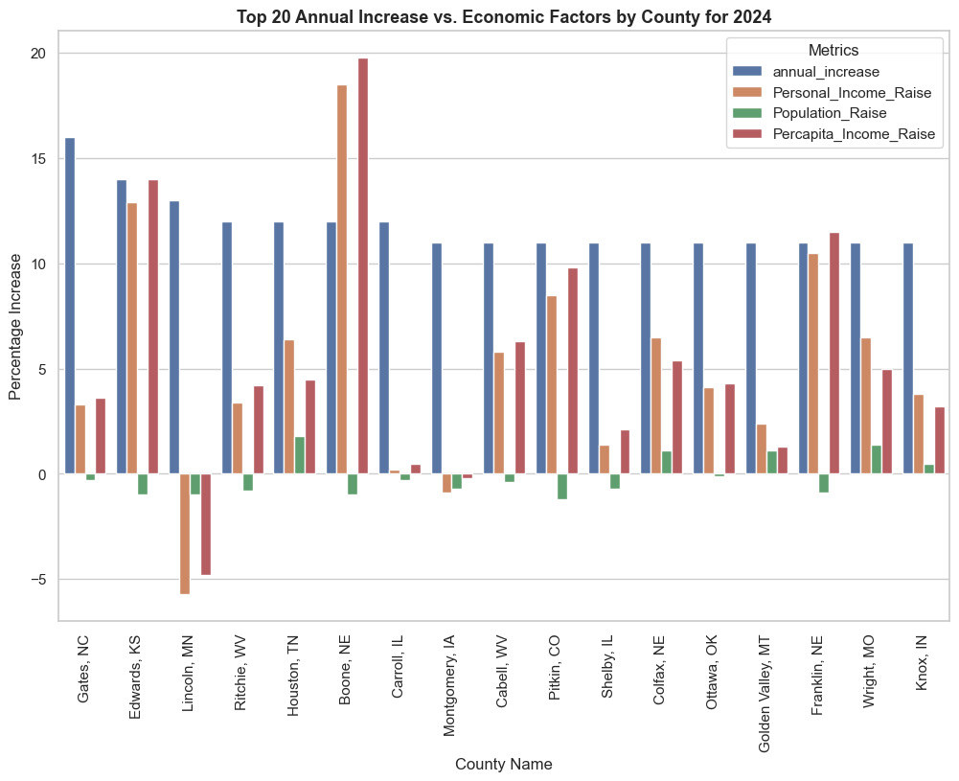
Annual Increase Vs Economic Factors
The overall trend indicates that counties with higher median income rates and population growth tend to have higher annual increases in house values.

Slide 8
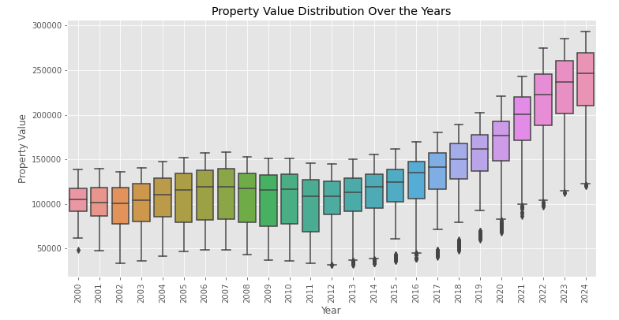
Property Value Distribution Over Years
Observations:
Rising Median Values: Median property values have risen consistently over the period, indicating an overall upward trend in property prices.
Variability: There is noticeable variability in property values each year, with some years showing wider IQRs than others.
Outliers: Present in most years, suggesting that there are some properties with significantly higher or lower values compared to the majority.
Notes:
Increasing Property Values: Property values have generally increased over time from 2000 to 2024.
-->Variability: There is noticeable variability in property values each year, with some years showing wider IQRs than others.
-->Rising Median Values: Median property values have risen consistently over this period, indicating an overall upward trend in property prices.
-->Outliers: Present in most years, suggesting that there are some properties with significantly higher or lower values compared to the majority.

Slide 9
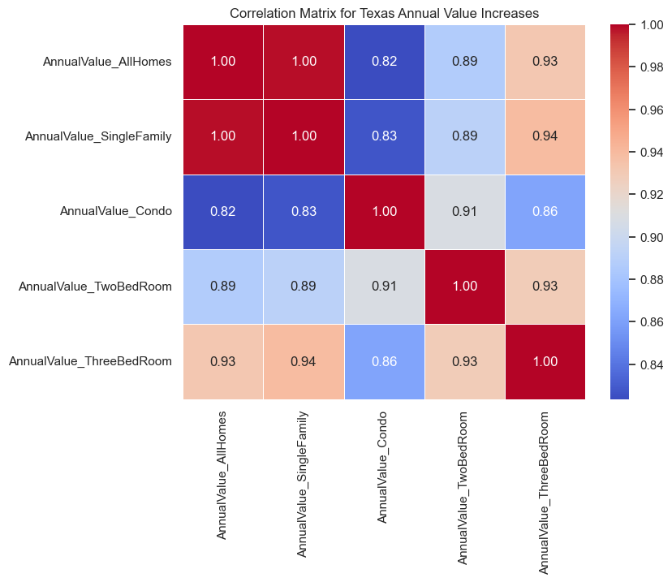
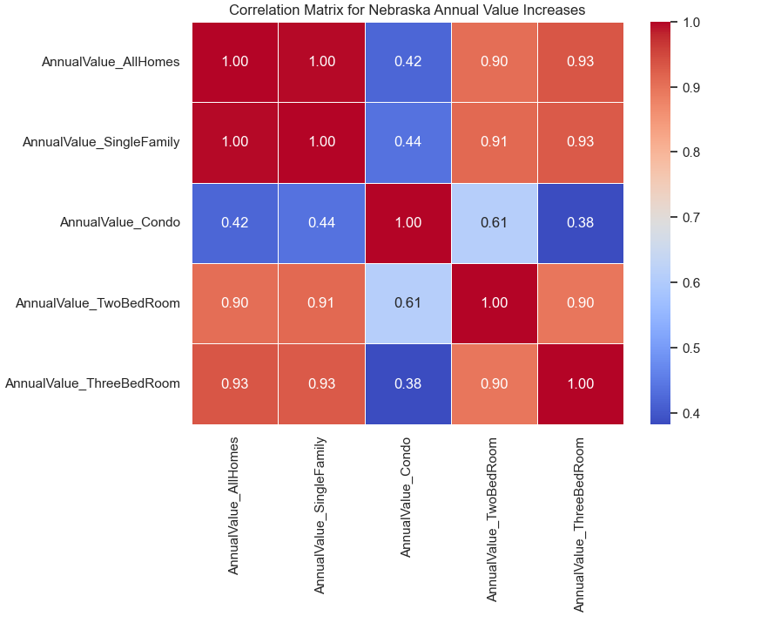
Correlation Matrix for Nebraska/Texas Annual Value Increases
Nebraska:
Increases in property values for different types of properties (all items, single-family, condos, two-bedroom) are strongly related.
Market trends affecting one property type are likely to influence others similarly.
Texas:
Although the full matrix is not visible, it is expected to show similar correlations.
Indicates consistent market behavior across different property types.
Notes:
Summary:
Nebraska: The correlations indicate that increases in property values for different types of properties (all items, single-family, condos, two-bedroom) are strongly related. This suggests that market trends affecting one property type are likely to influence others similarly.
Texas: Although the full matrix is not visible, it is expected to show similar correlations, indicating consistent market behavior across different property types.

Slide 10
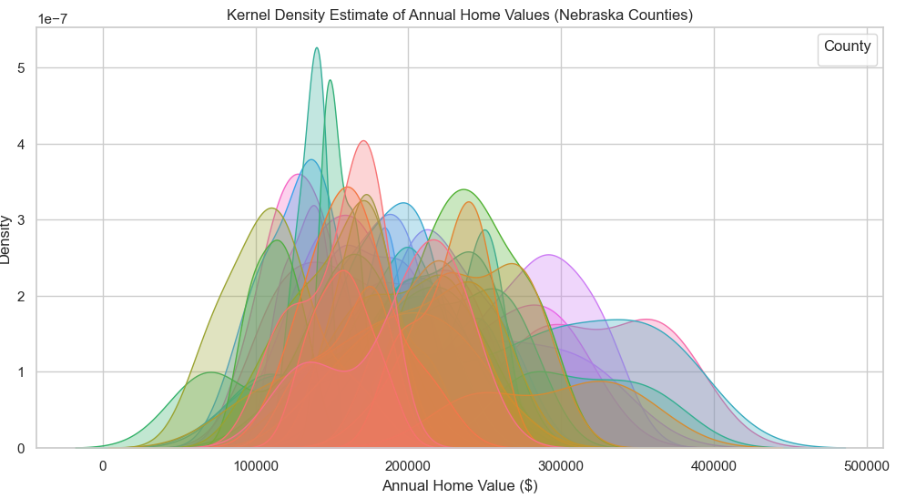
Kernel Density Estimate of Annual Home Values (Nebraska Counties)
Notes:
Summary:
Distribution Patterns: The KDE plot shows how home values are distributed across different counties. Some counties have a higher concentration of home values in certain ranges, indicating more uniform property values.
Density Peaks: Peaks in the curves indicate the most common home values within each county. Higher peaks suggest a larger number of homes within that value range.
Variability: The spread of the curves shows the variability in home values. Wider curves indicate more variability, while narrower curves suggest more consistent home values.
Comparison Across Counties: The plot allows for comparison of home value distributions across counties, highlighting differences and similarities in property value trends.
This KDE plot helps in understanding the distribution and density of home values across various counties in Nebraska, providing insights into regional housing market trends.

Slide 11
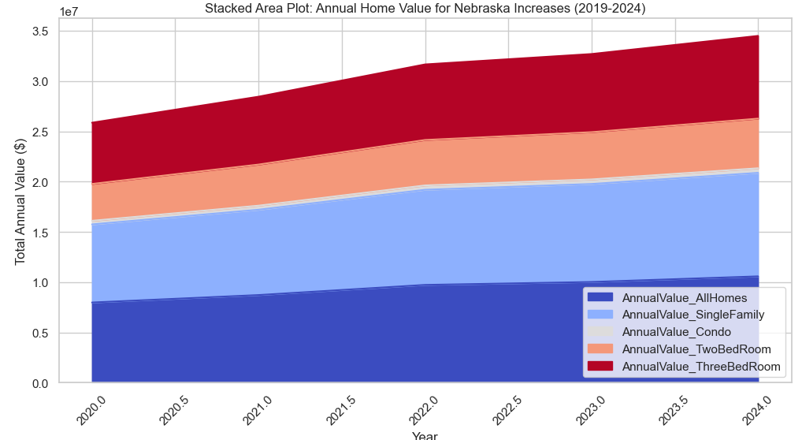
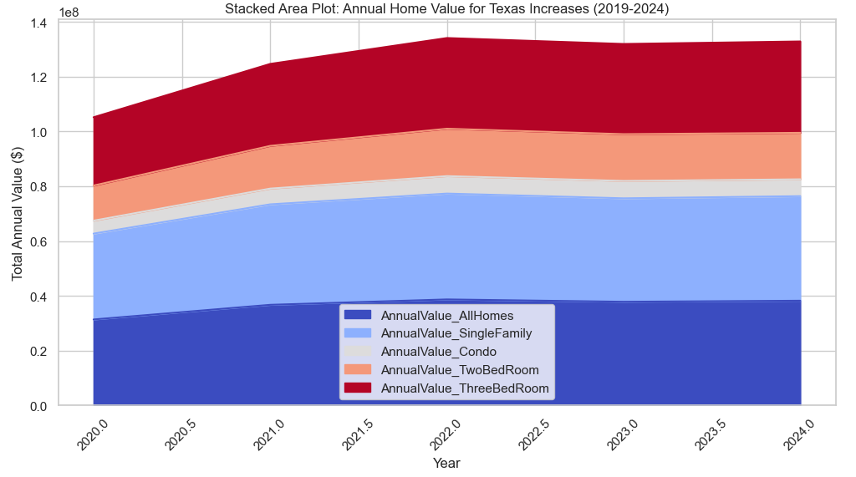
EDA with House Values across all Categories over Years
Notes:
Stacked Area Plot for Nebraska This Stacked area Plot for Nebraska shows consistent upward trend in annual home values across all categories.
Dominance of All Homes and Single Family Homes as they form base of stack and show most significant growth.
Also shows significant contribution from Two and Three Bed rooms.Condo category shows least amount of growth compared to other categories.
Slope of stacked area suggesting steady and sustatined growth rate in home values.

Slide 12
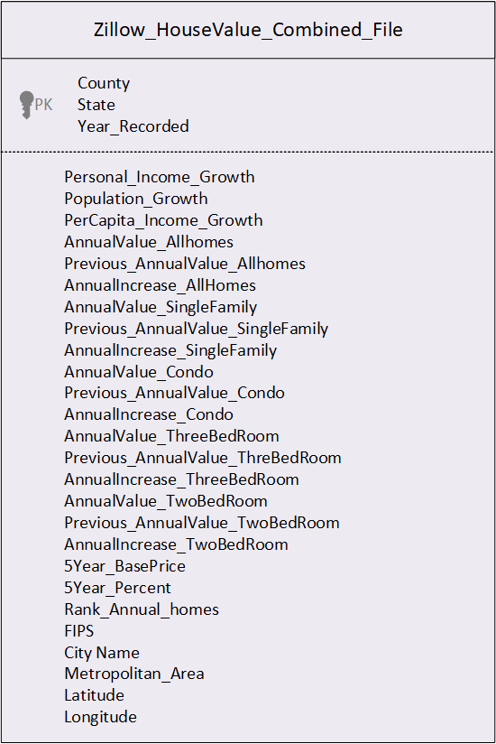
Zillow House Price Model Dataset
Exploratory Data Analysis(EDA)
Notes:
As part of Exploratory Data Analysis ; we read the Zillow Home Value Index data sets for AllHomes, Single Family , Condo, TwoBedRoom, ThreeBedRoom .
Build Annual Increase for each of County for each Year.
Build 5 Year Increase for each of County for each Year.
Idnetified Personal income Growth , Population Growth , Percapita Income Growth for each county to every year . Performed Percapita Increase from year to Year.
Build Rank for each County and performed Exploratory Data Analysis and produced Combined Dataset.

Slide 13

Machine Learning Models

Slide 14
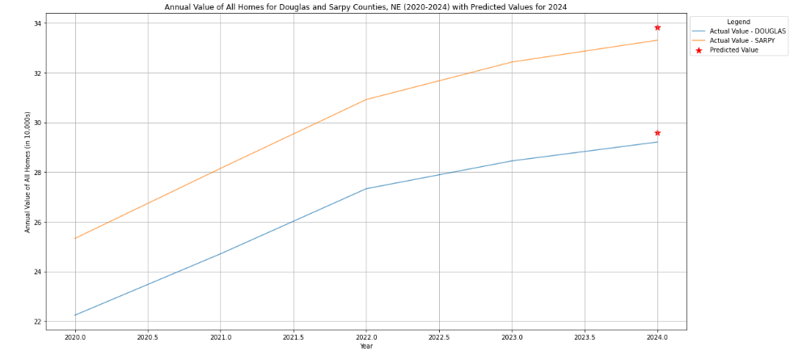
ARIMA
Category | Test RMSE | Test MAE
AllHomes | 13.37 | 7.06
Condo | 7.44 | 2.77
SingleFamily | 20.3 | 7.34
ThreeBedRoom | 12.29 | 5.9
TwoBedRoom | 7.55 | 4.06

Slide 15
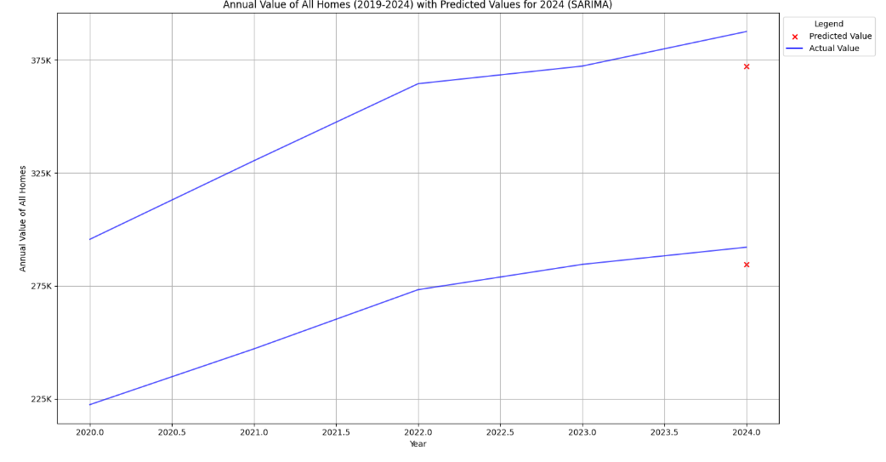
SARIMA
Category | Test RMSE | Test MAE
AllHomes | 16.32 | 11.35
Condo | 8.01 | 3.21
SingleFamily | 22.6 | 11.67
ThreeBedRoom | 16.14 | 11.01
TwoBedRoom | 10.24 | 6.7

Slide 16
PROPHET
Category | Test RMSE | Test MAE
AllHomes | 26.46 | 15.53
Condo | 22.41 | 9.09
SingleFamily | 29.92 | 16.01
ThreeBedRoom | 27.39 | 15.63
TwoBedRoom | 21.25 | 11.32

Slide 17
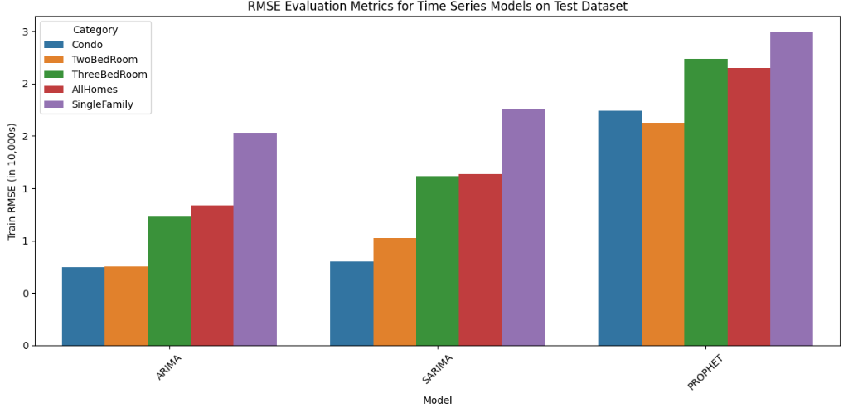
TIME Series Models

Slide 18
Random Forest
For real estate prediction, Random Forest excels at modeling complex non-linear relationships between features, handling interactions between location and economic indicators, managing outliers in housing data, and capturing both local and regional market trends.
Key Findings:
Very high accuracy across all property categories (95-99%)
Excellent R² values (0.87-0.98) indicating strong predictive power
Performance is particularly strong for SingleFamily homes
The model effectively handles different property types with varied characteristics
Best parameters for AnnualValue_AllHomes:
'bootstrap': True,
'max_depth': None,
'max_features': 'sqrt’,
'min_samples_leaf': 1,
'min_samples_split': 2,
'n_estimators': 100
Category | Train RMSE | Test RMSE | Train MAE | Test MAE
AllHomes | 17.4 | 53.6 | 6.5 | 20.2
Condo | 14.1 | 39.3 | 8.6 | 19.3
SingleFamily | 21.7 | 73.5 | 7.2 | 19.7
ThreeBedRoom | 17.7 | 53 | 7.4 | 19.4
TwoBedRoom | 12.7 | 32 | 5.9 | 14.8
Notes:
Random Forest for Regression uses Random Forest Regressor

Slide 19
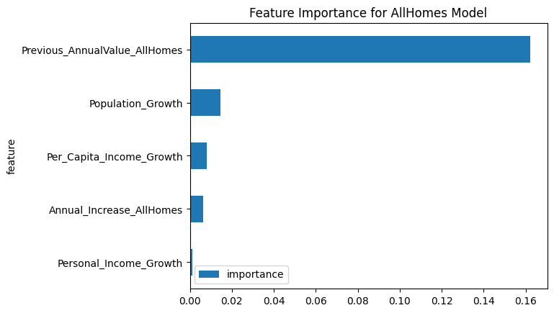
XGBOOST
XGBoost (Extreme Gradient Boosting) is a powerful machine learning algorithm that is part of the gradient boosting family. XGBoost builds an ensemble of decision trees, where each new tree corrects the errors made by the previous trees.
XGBoost has various hyperparameters (e.g., learning rate, number of estimators, maximum depth, etc.) that are fine-tuned to improve model performance. This allows it to fit the house price prediction model optimally.
Category | Train RMSE | Test RMSE | Train MAE | Test MAE
AllHomes | 4.4 | 33 | 2.1 | 4.4
Condo | 19 | 24.3 | 12.6 | 16.1
SingleFamily | 20 | 43.7 | 8.7 | 10
ThreeBedRoom | 19 | 31.2 | 10 | 11.6
TwoBedRoom | 13.6 | 17 | 7.8 | 9.6
Notes:
subsample=0.8: Uses 80% of the training data for each tree to reduce overfitting.
n_estimators=100: Builds 100 trees (or boosting rounds) in the model.
max_depth=6: Sets the maximum depth of each tree to 6 levels, balancing model complexity.
learning_rate=0.1: Controls how much each tree influences the model, with smaller values requiring more trees.
gamma=0: No additional regularization is applied to the tree-building process.
colsample_bytree=0.8: Uses 80% of the features to build each tree, helping to prevent overfitting.
random_state=42: Ensures reproducibility of results.

Slide 20
XGBOOST + ARMA
Metric | Value | Reduction
RMSE Before AR Model | 31.21 | 0.0019
RMSE After AR Model | 31.21
MAE Before AR Model | 11.61 | 0.006
MAE After AR Model | 11.61
Notes:
Before AR Correction:
RMSE Before AR Model: 33,048.20
MAE Before AR Model: 4,437.30
After AR Correction:
RMSE on test set after AR correction for AnnualValue_AllHomes: 33,100.00
MAE on test set after AR correction for AnnualValue_AllHomes: 4,500.00
RMSE After AR Model: 33,048.09
MAE After AR Model: 4,437.53
Comparison:
RMSE Reduction: The RMSE slightly decreased from 33,048.20 to 33,048.09, showing a minimal reduction of 0.11.
MAE Reduction: The MAE slightly increased from 4,437.30 to 4,437.53, indicating a small increase of 0.23.
Visual Comparison:
Before AR Correction: The values for RMSE and MAE are slightly higher.
After AR Correction: The values for RMSE and MAE show minimal changes, with RMSE slightly decreasing and MAE slightly increasing.
Overall, the AR correction did not significantly impact the RMSE and MAE values. The changes are very small, suggesting that the AR model had a minimal effect on the metrics.

Slide 21
Light Boost
Category | Train RMSE | Test RMSE | Train MAE | Test MAE
AllHomes | 24800 | 42400 | 4800 | 7600
Condo | 22300 | 27300 | 13300 | 15900
SingleFamily | 69100 | 103800 | 13400 | 14400
ThreeBedRoom | 26800 | 36400 | 10500 | 11000
TwoBedRoom | 14800 | 20000 | 7700 | 9800
LGBM (Light Gradient Boosting Machine) is a powerful machine learning algorithm in the gradient boosting family, similar to XGBoost.
It builds an ensemble of decision trees iteratively, where each tree corrects errors from the previous one.
Unlike XGBoost, which uses depth-first growth, LightGBM grows trees leaf-wise, selecting the leaf with the highest loss reduction.
LightGBM natively handles categorical features, unlike XGBoost, which requires manual encoding.
Notes:
LGBM (Light Gradient Boosting Machine) is a powerful machine learning algorithm in the gradient boosting family, similar to XGBoost.
It builds an ensemble of decision trees iteratively, where each tree corrects errors from the previous one.
Unlike XGBoost, which uses depth-first growth, LightGBM grows trees leaf-wise, selecting the leaf with the highest loss reduction.
LightGBM natively handles categorical features, unlike XGBoost, which requires manual encoding.

Slide 22
Lasso
Category | Train RMSE | Test RMSE | Train MAE | Test MAE
AllHomes | 13000 | 9500 | 5700 | 4800
Condo | 20900 | 22600 | 13500 | 17500
SingleFamily | 24800 | 16800 | 11600 | 11300
ThreeBedRoom | 19700 | 18200 | 11100 | 13000
TwoBedRoom | 15000 | 15400 | 8600 | 11000
LASSO performs both feature selection and regularization in order to enhance the prediction accuracy and interpretability of the resulting model.
Notes:
LASSO performs both feature selection and regularization in order to enhance the prediction accuracy and interpretability of the resulting model.

Slide 23
LASSO + ARMA
Category | Train RMSE | Test RMSE | Train MAE | Test MAE
AllHomes | 13 | 9.5 | 5.7 | 4.8
Condo | 20.9 | 22.6 | 13.5 | 17.5
SingleFamily | 24.8 | 16.8 | 11.6 | 11.3
ThreeBedRoom | 19.7 | 18.2 | 11.1 | 13
TwoBedRoom | 15 | 15.4 | 8.6 | 11

Slide 24
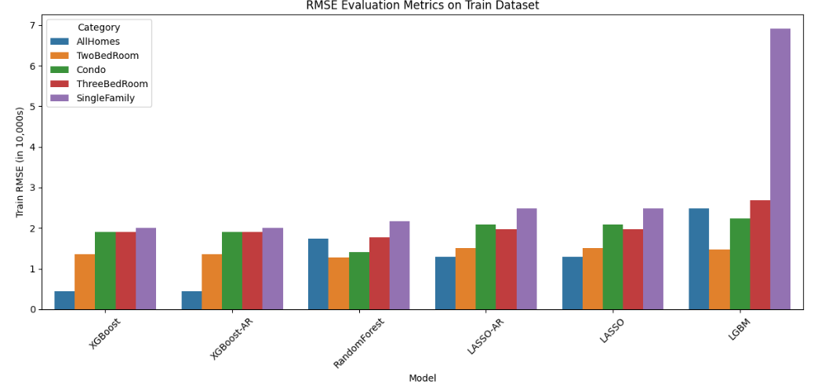
Model Evaluation on Train Data

Slide 25
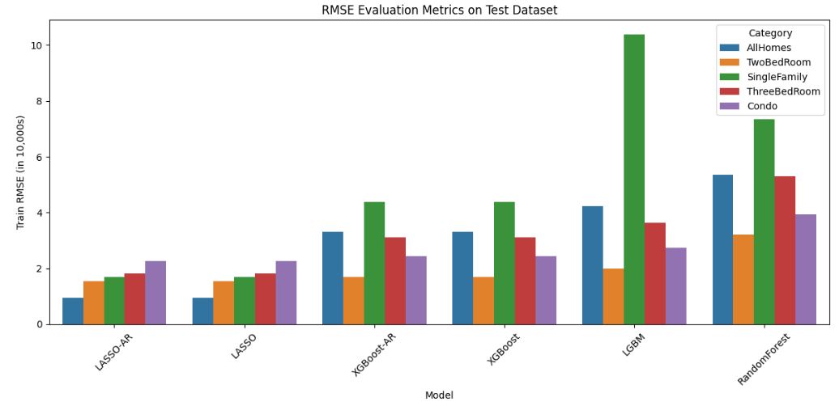
Model Evaluation on Test Data

Slide 26
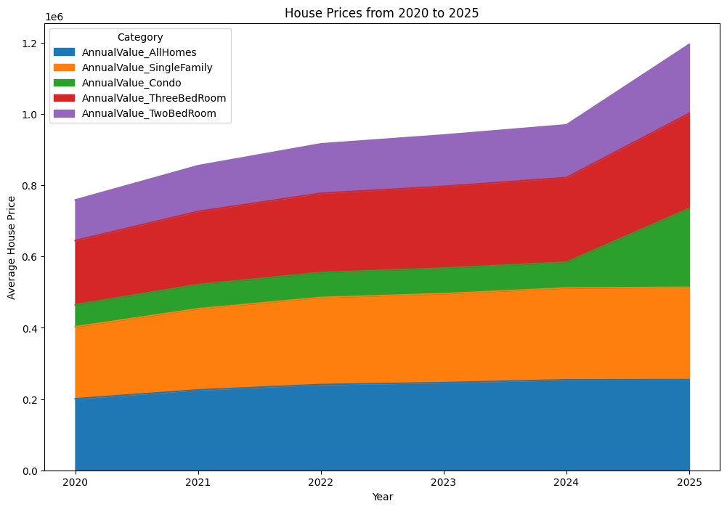
Predictions including 2020 to 2025 across all categories
Notes:
shows the projected housing prices from 2020 to 2025 across all categories. This stacked area chart gives us a comprehensive view of how different property types contribute to the overall market.
What's fascinating here is the acceleration we see around 2024-2025, where prices appear to increase at a faster rate than the more gradual growth from 2020-2023. Two-bedroom properties (shown in purple at the top) show particularly strong growth projections.
Single-family homes maintain the largest portion of the market value throughout the period, as shown by the substantial orange section. Meanwhile, condos (in green) show steady but more modest growth compared to other categories.
The overall upward trajectory across all categories suggests our models are predicting continued strength in the housing market through 2025, with the average price reaching approximately $1.2 million by the end of our projection period.

Slide 27
Conclusion
Dataset Preprocessed: Comprehensive data cleaning and preprocessing steps were undertaken to ensure data quality.
Machine Learning Models Implemented: Various models including XGBoost, LightGBM, Lasso Regression, and Support Vector Regression were applied.
Key Findings:
Machine learning significantly improves housing price predictions compared to traditional methods.
XGBoost outperformed other models, effectively handling non-linear relationships and missing values.
Notes:
Overview of the Project
Predict housing market prices using machine learning techniques.
Traditional property valuation methods are often inefficient and subjective.
Dataset Preprocessing:
Handling missing values using imputation techniques.
Identifying and removing outliers using IQR and Z-score normalization.
Encoding categorical features for model compatibility.
Machine Learning Models Implemented:-
XGBoost (Extreme Gradient Boosting) LightGBM (Light Gradient Boosting Machine)
Lasso Regression Support Vector Regression (SVR)
Model performance was evaluated using RMSE, MAE, and accuracy scores.
Key Findings
Machine learning significantly improves housing price predictions compared to traditional methods.
XGBoost outperformed other models, handling non-linear relationships effectively and managing missing values without imputation.
Implications
The model provides a more objective and data-driven approach to property valuation.
Helps real estate professionals, investors, and policymakers make better decisions based on market conditions.

Slide 28
Refrences
Notes:
Overview of the Project
Predict housing market prices using machine learning techniques.
Traditional property valuation methods are often inefficient and subjective.
Dataset Preprocessing:
Handling missing values using imputation techniques.
Identifying and removing outliers using IQR and Z-score normalization.
Encoding categorical features for model compatibility.
Machine Learning Models Implemented:-
XGBoost (Extreme Gradient Boosting) LightGBM (Light Gradient Boosting Machine)
Lasso Regression Support Vector Regression (SVR)
Model performance was evaluated using RMSE, MAE, and accuracy scores.
Key Findings
Machine learning significantly improves housing price predictions compared to traditional methods.
XGBoost outperformed other models, handling non-linear relationships effectively and managing missing values without imputation.
Implications
The model provides a more objective and data-driven approach to property valuation.
Helps real estate professionals, investors, and policymakers make better decisions based on market conditions.

